Slide 1


Tommy Chen
26 April 2024

Slide 2

Outline
Executive Summary
Introduction
Methodology
Results
Conclusion
Appendix

Slide 3
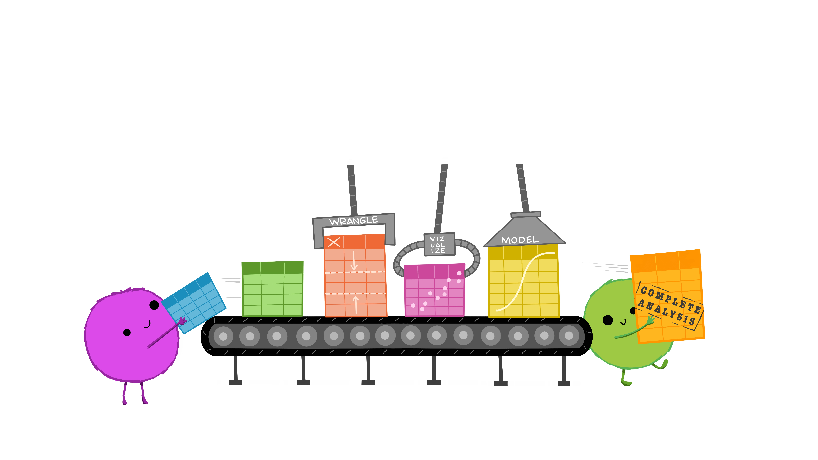
Executive Summary
General improvement with launch successes over time.
Dashboard built to monitor progress.
Model trained to help predict what the outcome of future launches would be.
Overall improvements made so that future launches will have the best setup to succeed

Slide 4
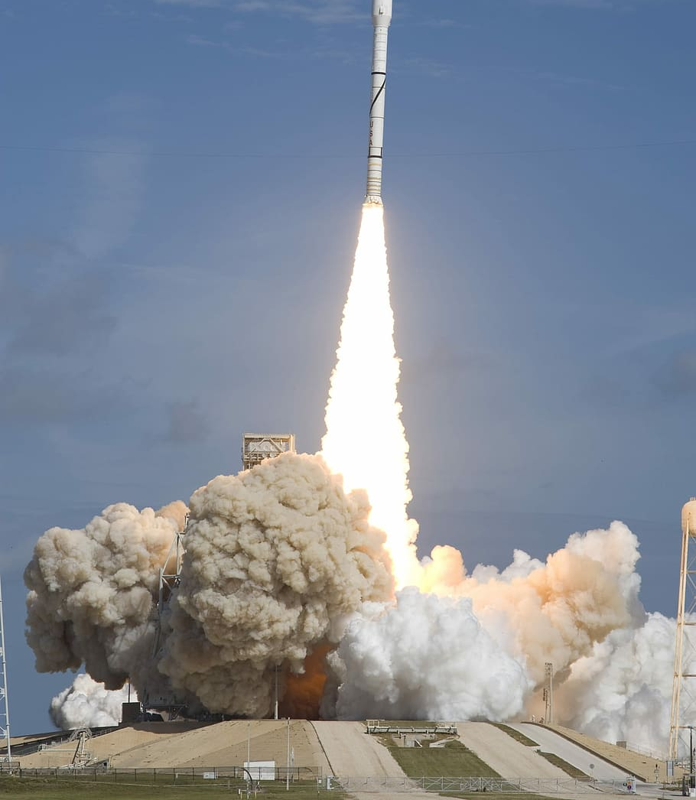
Introduction
Rocket launches are very expensive $50m - $162m
Tesla has designed reusable rockets that can cut the cost significantly
Important to be able to understand whether launch will succeed or fail
Also need to understand the factors contributing to success or failure of a launch

Slide 5

Section 1

Slide 6
Methodology
Executive Summary
Data collection methodology:
Data scraped from SpaceX API
Perform data wrangling
Datasets structured and cleaned using pandas
Perform exploratory data analysis (EDA) using visualization and SQL
Perform interactive visual analytics using Folium and Plotly Dash
Perform predictive analysis using classification models
Grid Search with different models used to determine the best fitting model
This Photo by Unknown Author is licensed under CC BY

Slide 7
Data Collection
SpaceX API
Web scraping using Beautiful Soup
Data Processing and cleaning

Slide 8
Data Collection – SpaceX API
Notebook
Call
SpaceX API
Response
Further processing steps
https://github.com/tommychen741/Applied-Data-Science-Capstone/blob/main/1_jupyter-labs-spacex-data-collection-api.ipynb

Slide 9
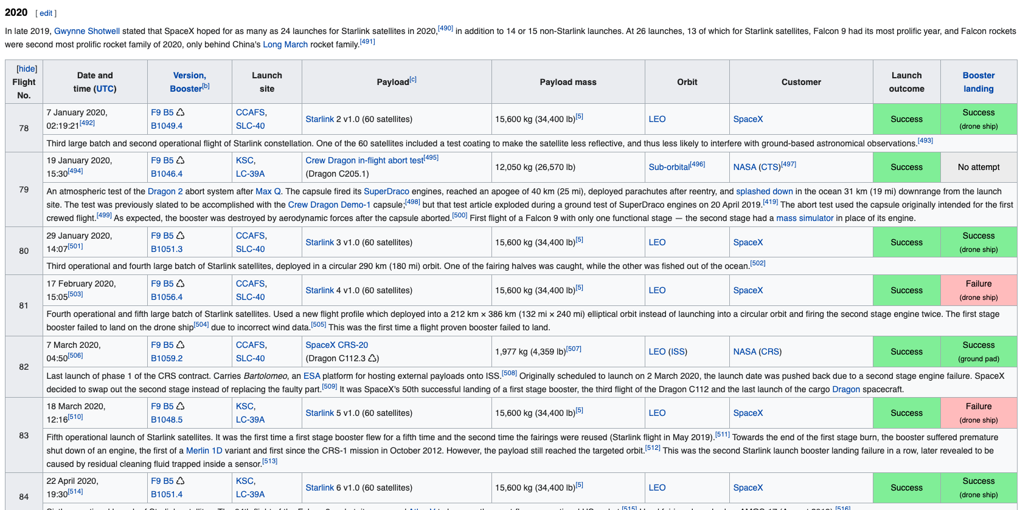
Data Collection - Scraping
Extraction of column headings
Extraction of data values
https://github.com/tommychen741/Applied-Data-Science-Capstone/blob/main/1_jupyter-labs-spacex-data-collection-api.ipynb

Slide 10

Data Wrangling
Dataset restricted to falcon 9 data
Data types made to be consistent
Non sensical rows dropped
Missing values were replaced with the average
Different outcomes normalized to succeed vs fail
https://github.com/tommychen741/Applied-Data-Science-Capstone/blob/main/3_labs-jupyter-spacex-Data%20wrangling.ipynb
This Photo by Unknown Author is licensed under CC BY

Slide 11
EDA with Data Visualization
Scatter plot to show relationship between different variables
Bar plot to show differences by category
Line plot to show trends over time
https://github.com/tommychen741/Applied-Data-Science-Capstone/blob/main/4_edadataviz.ipynb

Slide 12
EDA with SQL
SQL queries done:
Launch sites
Total payload mass
Average payload mass for booster version F9 v1.1
First successful ground pad landing
Different booster versions that were successful on drone with payload of between 4000 and 6000
Landing outcomes between 2010 and 2017
…and more
https://github.com/tommychen741/Applied-Data-Science-Capstone/blob/main/4_edadataviz.ipynb

Slide 13
Build an Interactive Map with Folium
Markers and circles used to signify landing sites
Marker clusters for each mission at landing site created
Successful launches were shown as green
Failed launches shown as red
https://github.com/tommychen741/Applied-Data-Science-Capstone/blob/main/6_lab_jupyter_launch_site_location.ipynb

Slide 14
Build a Dashboard with Plotly Dash
Dashboard allows users to select launch site and see success rate
User can also select payload ranges they want to view
Pie chart shows success rate
Scatter plot shows success rate across different payloads and booster versions
https://github.com/tommychen741/Applied-Data-Science-Capstone/blob/main/7_Dashboard_code.py

Slide 15
Predictive Analysis (Classification)
Following models were tested:
Logistic Regression
SVM
Decision Tree
K Nearest Neighbours
Models assessed on:
Confusion matrix
Accuracy
https://github.com/tommychen741/Applied-Data-Science-Capstone/blob/main/8_SpaceX_Machine%20Learning%20Prediction.ipynb

Slide 16
Results
Exploratory data analysis results
Interactive analytics demo in screenshots
Predictive analysis results

Slide 17

Section 2

Slide 18
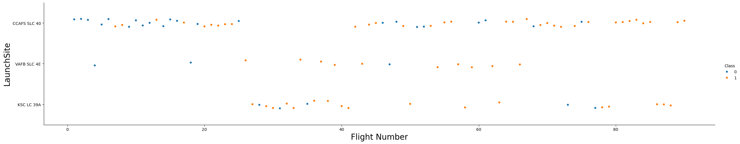
Flight Number vs. Launch Site
Improvement across all launch sites with more recent launches more likely to succeed

Slide 19
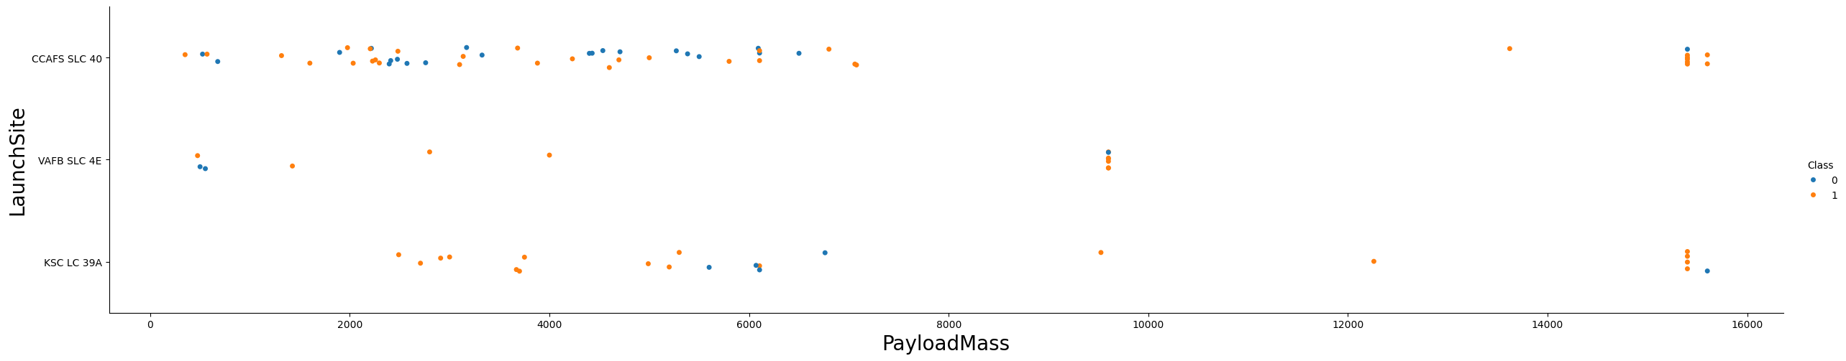
Payload vs. Launch Site
VAFB SLC 4E not doing any launches where payload is greater than 10,000

Slide 20
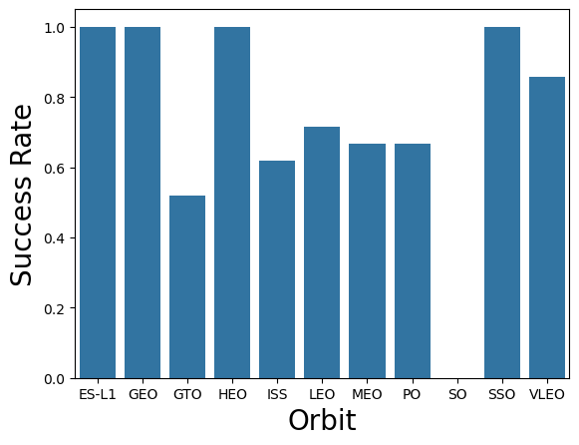
Success Rate vs. Orbit Type
ES-L1, GEO, HEO and SSO all have 100% success rates
SO site has not succeeded yet

Slide 21
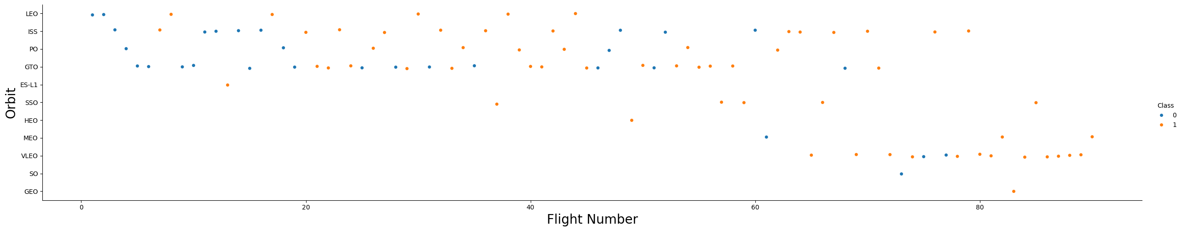
Flight Number vs. Orbit Type
Improving success rate across all orbits
Most recent launches at VLEO

Slide 22
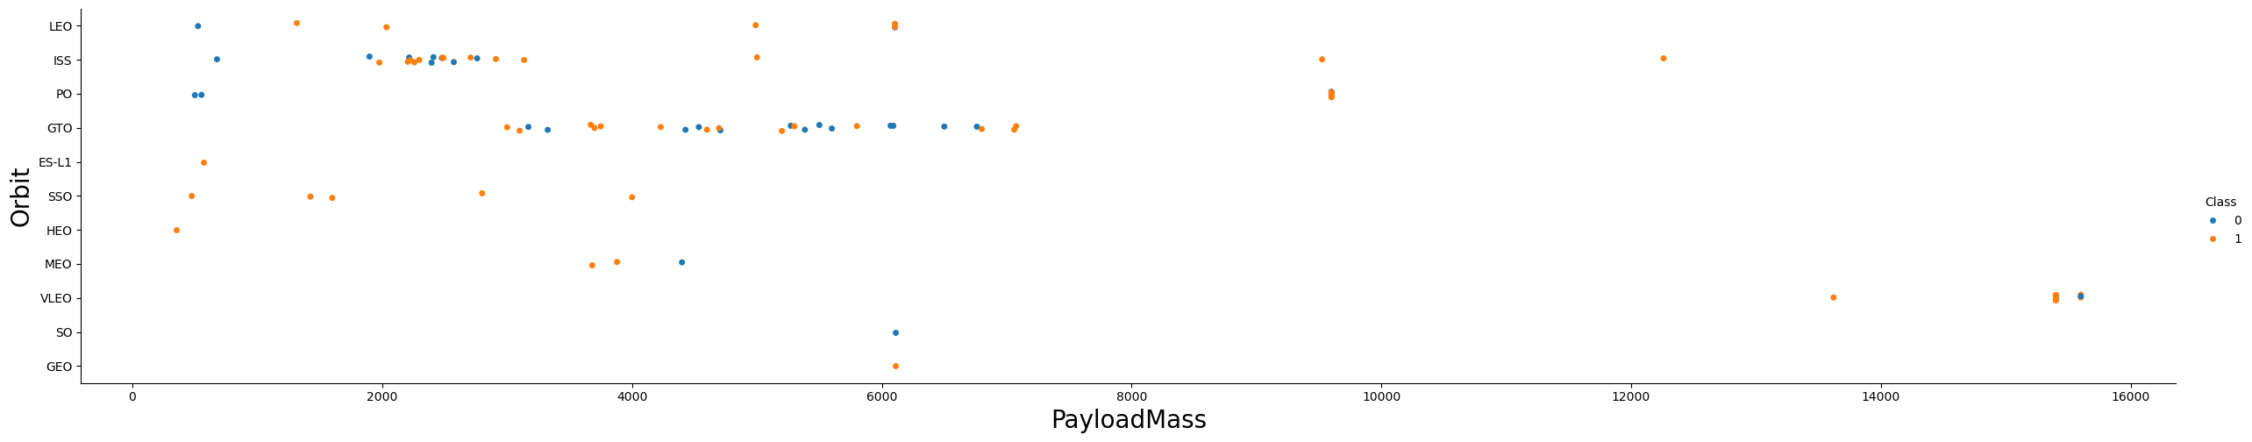
Payload vs. Orbit Type
Show a scatter point of payload vs. orbit type
Show the screenshot of the scatter plot with explanations
Heavier payloads done for ISS, PO and VLEO
Low payloads were from initial flights

Slide 23
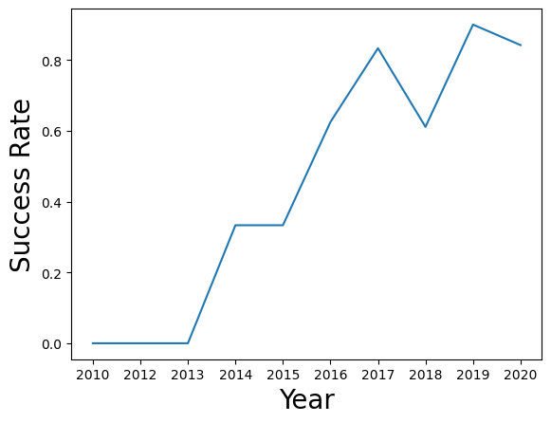
Launch Success Yearly Trend
Increasing success rate over time

Slide 24
All Launch Site Names
Launch_Site
CCAFS LC-40
VAFB SLC-4E
KSC LC-39A
CCAFS SLC-40
List of different launch sites in analysis

Slide 25
Launch Site Names Begin with 'CCA'
5 records where launch sites begin with `CCA`
Date | Time (UTC) | Booster_Version | Launch_Site | Payload | PAYLOAD_MASS__KG_ | Orbit | Customer | Mission_Outcome | Landing_Outcome
2010-06-04 | 18:45:00 | F9 v1.0 B0003 | CCAFS LC-40 | Dragon Spacecraft Qualification Unit | 0 | LEO | SpaceX | Success | Failure (parachute)
2010-12-08 | 15:43:00 | F9 v1.0 B0004 | CCAFS LC-40 | Dragon demo flight C1, two CubeSats, barrel of Brouere cheese | 0 | LEO (ISS) | NASA (COTS) NRO | Success | Failure (parachute)
2012-05-22 | 7:44:00 | F9 v1.0 B0005 | CCAFS LC-40 | Dragon demo flight C2 | 525 | LEO (ISS) | NASA (COTS) | Success | No attempt
2012-10-08 | 0:35:00 | F9 v1.0 B0006 | CCAFS LC-40 | SpaceX CRS-1 | 500 | LEO (ISS) | NASA (CRS) | Success | No attempt
2013-03-01 | 15:10:00 | F9 v1.0 B0007 | CCAFS LC-40 | SpaceX CRS-2 | 677 | LEO (ISS) | NASA (CRS) | Success | No attempt

Slide 26
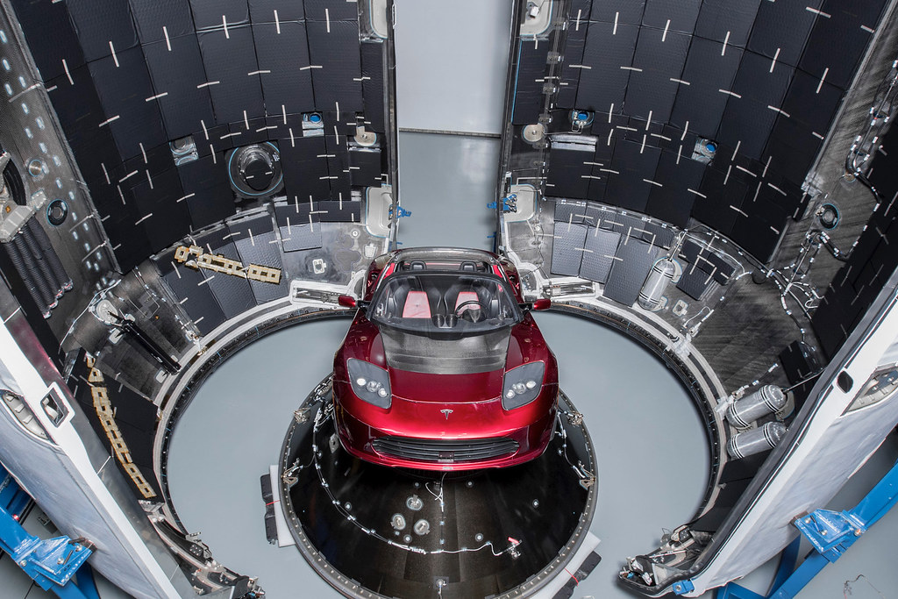
Total Payload Mass
total payload carried by boosters from NASA
45,596

Slide 27
Average Payload Mass by F9 v1.1
Average payload mass carried by booster version F9 v1.1:
2,928.4

Slide 28
First Successful Ground Landing Date
Date of the first successful landing outcome on ground pad:
2015-12-22

Slide 29
Successful Drone Ship Landing with Payload between 4000 and 6000
Booster_Version
F9 FT B1022
F9 FT B1026
F9 FT B1021.2
F9 FT B1031.2
Names of boosters which have successfully landed on drone ship and had payload mass greater than 4000 but less than 6000

Slide 30
Total Number of Successful and Failure Mission Outcomes
Mission_Outcome | Missions
Failure (in flight) | 1
Success | 98
Success | 1
Success (payload status unclear) | 1
Total number of successful and failure mission outcomes

Slide 31
Boosters Carried Maximum Payload
Booster_Version
F9 B5 B1048.4
F9 B5 B1049.4
F9 B5 B1051.3
F9 B5 B1056.4
F9 B5 B1048.5
F9 B5 B1051.4
F9 B5 B1049.5
F9 B5 B1060.2
F9 B5 B1058.3
F9 B5 B1051.6
F9 B5 B1060.3
F9 B5 B1049.7
Names of the booster which have carried the maximum payload mass

Slide 32
2015 Launch Records
Failed landing_outcomes in drone ship, their booster versions, and launch site names for in year 2015
Month | Landing_Outcome | Booster_Version | Launch_Site
01 | Failure (drone ship) | F9 v1.1 B1012 | CCAFS LC-40
04 | Failure (drone ship) | F9 v1.1 B1015 | CCAFS LC-40

Slide 33
Rank Landing Outcomes Between 2010-06-04 and 2017-03-20
Landing_Outcome | missions
No attempt | 10
Success (drone ship) | 5
Failure (drone ship) | 5
Success (ground pad) | 3
Controlled (ocean) | 3
Uncontrolled (ocean) | 2
Failure (parachute) | 2
Precluded (drone ship) | 1
Count of landing outcomes (such as Failure (drone ship) or Success (ground pad)) between the date 2010-06-04 and 2017-03-20, in descending order

Slide 34

Section 3

Slide 35
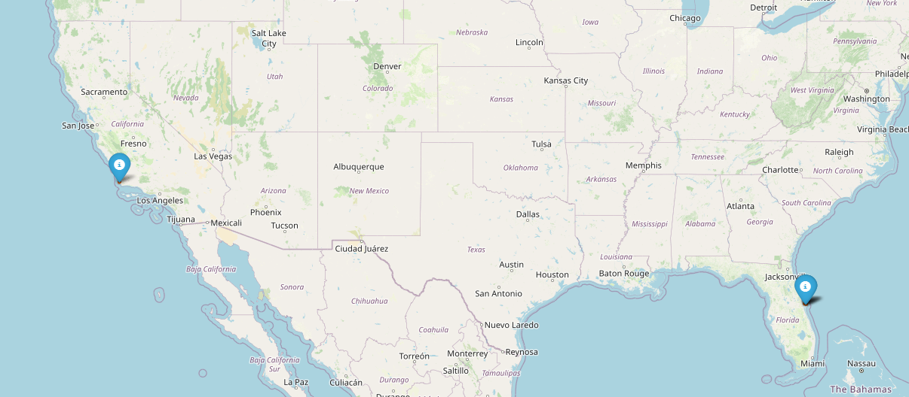
Folium map with launch sites
This shows where the different launch sites are distributed

Slide 36
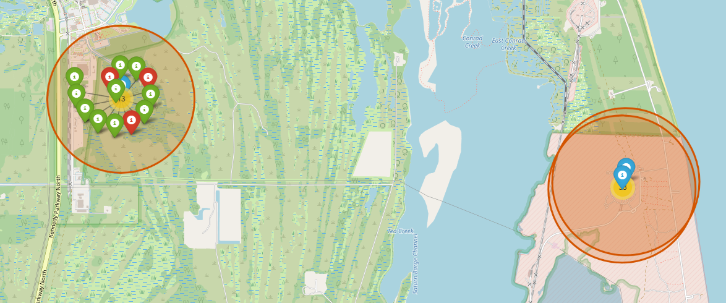
Launch site mission breakdown
Shows successful and failed launches at each site

Slide 37

Distance to other locations
Distance to coastline

Slide 38

Section 4

Slide 39
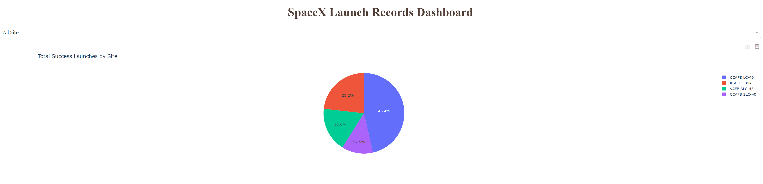
Launch successes across all sites
Most launches come from CCAFS LC-40

Slide 40
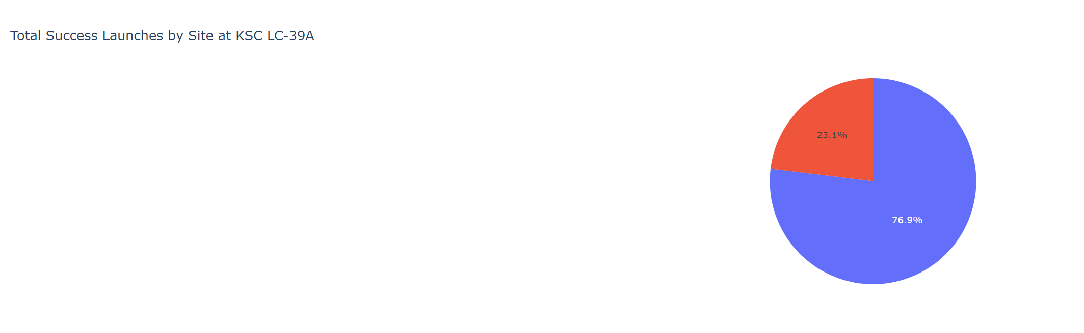
Most successful site
Most successful launches at KSC LC-39A

Slide 41
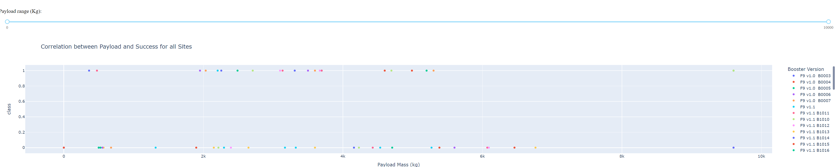
Payload vs Launch outcome
User able to select different payloads and see success rates for different booster versions

Slide 42

Section 5

Slide 43
Classification Accuracy
All models performed comparably apart from decision tree model

Slide 44
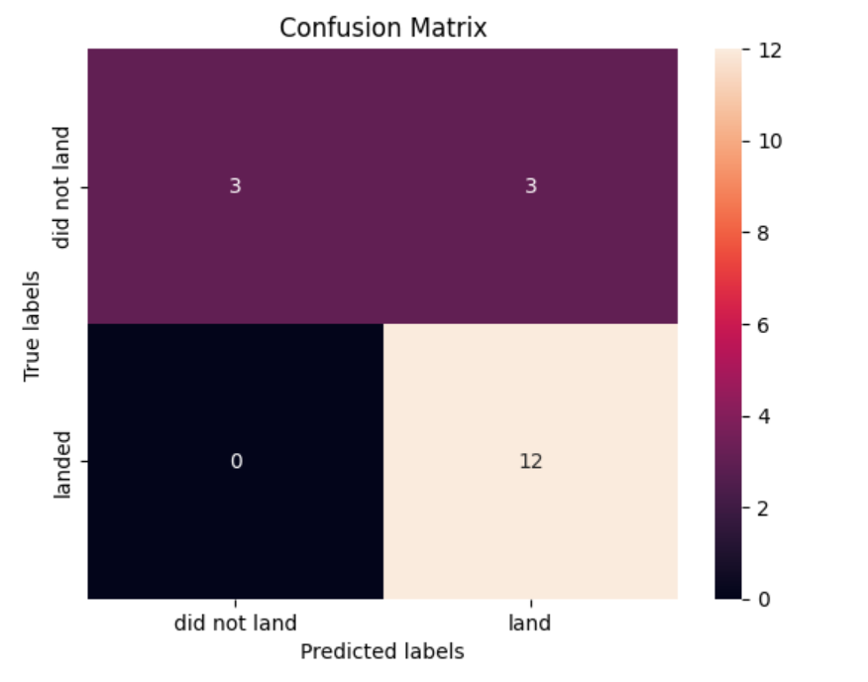
Confusion Matrix
3 out of 18 cases with a wrong prediction
Rest were predicted correctly (5/18)

Slide 45
Conclusions
General improvement with launch successes over time.
Dashboard built to monitor progress.
Model trained to help predict what the outcome of future launches would be.
Overall improvements made so that future launches will have the best setup to succeed

Slide 46


